Slide 1

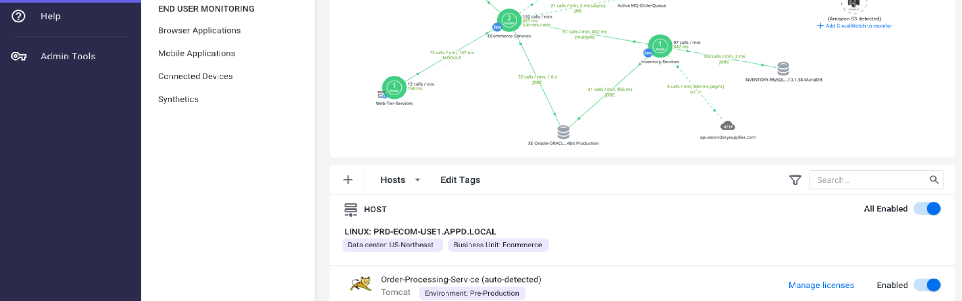
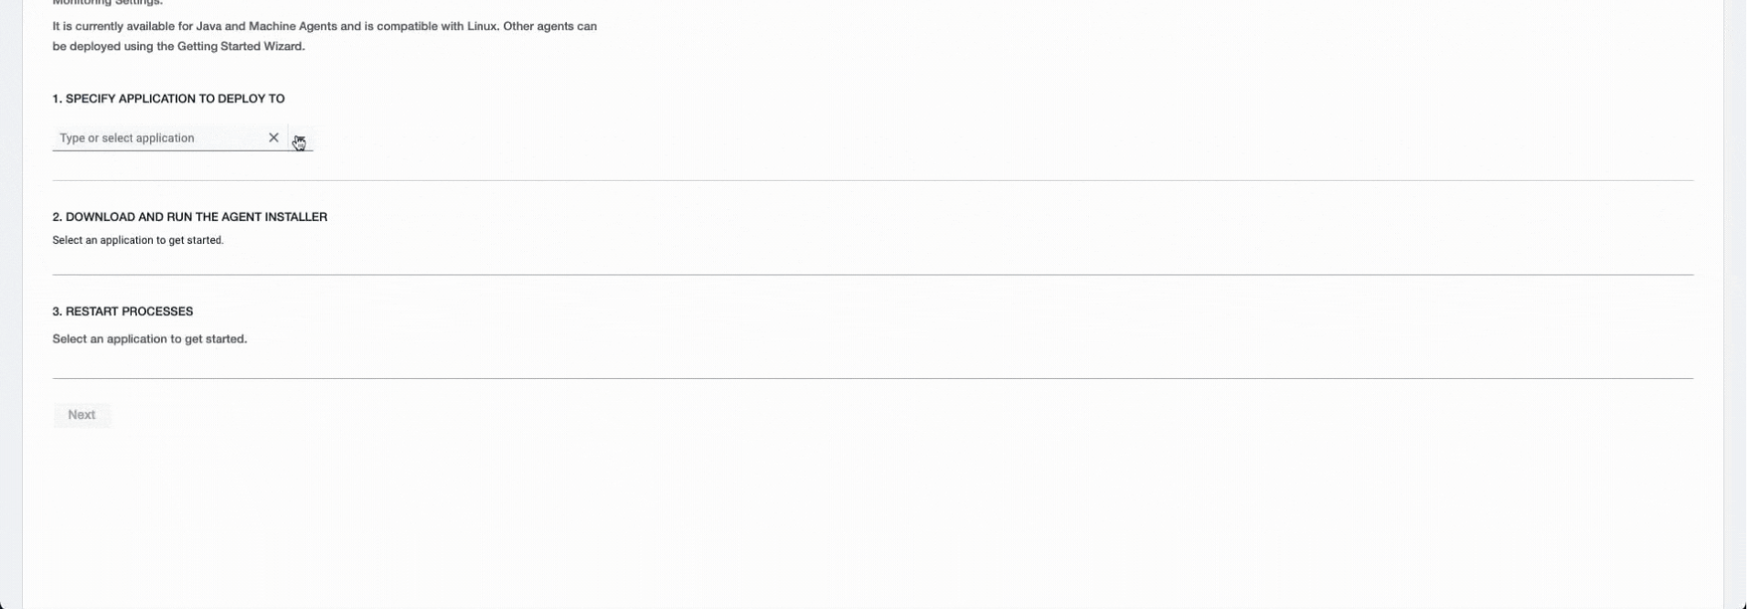
AppDynamics
Simplifying Agent Installation
Simplifying Agent Installation for Speed and Efficiency
Notes:
AppDynamics allows business to monitor the performance of their most valuable Apps
This monitoring and reporting is done by something called agents
Agents are like watch dogs, or a smoke alarm, that alert DevOps engineers of any potential failure within their application environment

Slide 2

Agent installation had become a customer pain point, leading to lengthy setup times and lost contracts.
Notes:
Installing monitoring agents at scale was a bottleneck for enterprise clients
Agent install is one of the most painful experiences within AppDynamics
Agent install is a very manual process and has led to the loss of contracts
The agents need to be downloaded and installed one at a time
There’s no way to download multiple agents all at once
There’s no way to pause or resume monitoring in the UI.
Updating the agents is also a manual process
No ability to trigger an update across all the agents
Before an agent is deployed, it must first be mapped to an app and tier

Slide 3

Reducing Complexity
Notes:
As the lead designer, I collaborated with engineering and product teams to deliver a scalable platform that empowered developers to deploy agents efficiently.
I owned the end-to-end redesign, from competitive analysis to prototype testing and stakeholder presentations.
Leading user research to validate assumptions and gain user insights.
Designing a streamlined, automated solution that would enhance setup efficiency and clarity.
Role: Led design overhaul, collaborating with Product, Engineering, and Research teams to create a streamlined installation experience.
Who I partnered with
Engineering leads
Product Managers
UX Research team
My Role
Led a design team of 2 from my team of 5 direct reports.
Project planning, requirements gathering and strategy
User Journeys, wireframing and prototyping
Research and customer interviews
Executive presentations.

Slide 4
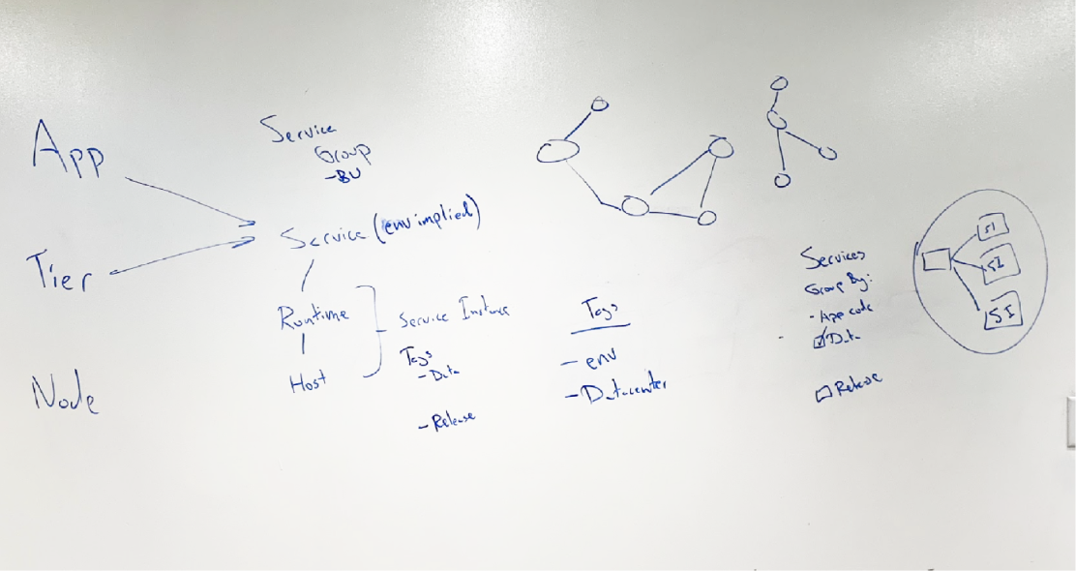
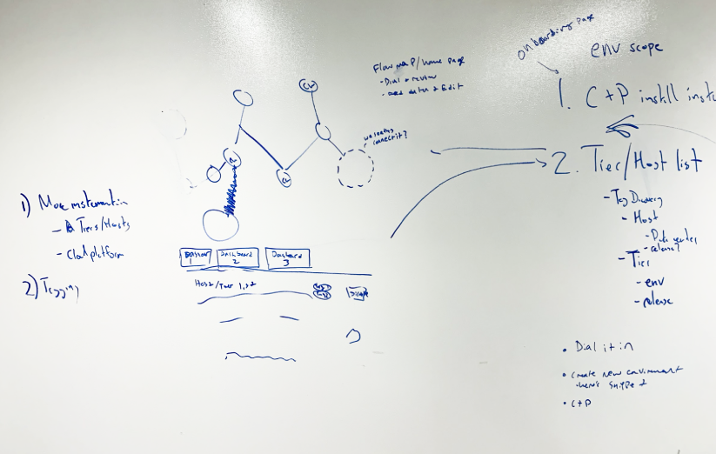
Feasibility
partners
Notes:
To accelerate progress, I worked closely with engineers to prototype early solutions, enabling them to start development while refining user flows.
This was complex, but....
It’s basically a grouping and sorting exercise. People had objects; in this case processes, that were part of a virtual host environment, and they needed to be grouped into apps and tiers for monitoring. This all sat on a physical server.
Part of what took so long during set up is that before an agent could be deployed, it had to be physically mapped to a specific app and tier. Any additional categorization had to be included as part of lengthy naming structure.
Each agent had to be downloaded one at a time, with no ability to download all the agents at once. Some companies have thousands of apps, across hundreds of servers.
Once agents start reporting, they visually map onto a topology we call the flow map.
I wondered if we could take this flow map and make it part of the agent install experience to visually illustrate that the agents installed correctly, and show how the environment was connected?
Once we had a vision we aspired to, we set out to build it.

Slide 5




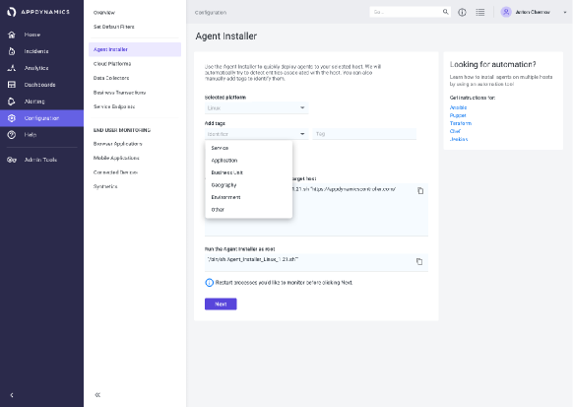
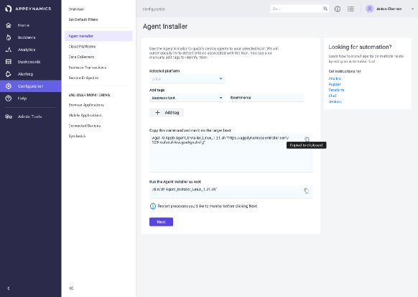
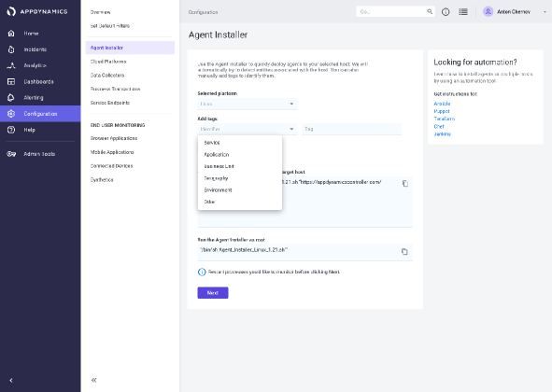
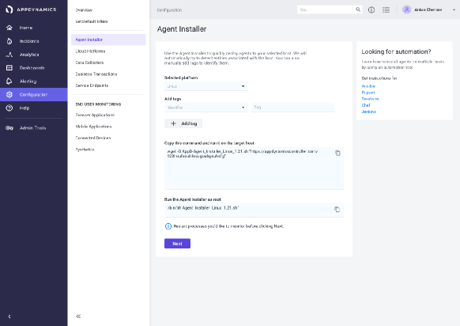
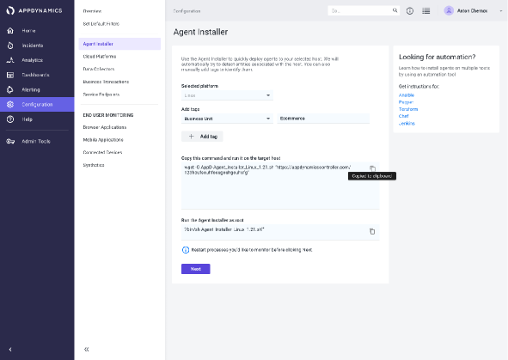
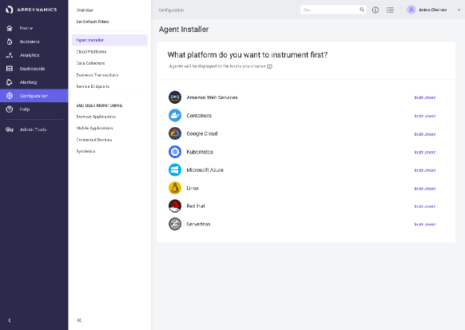
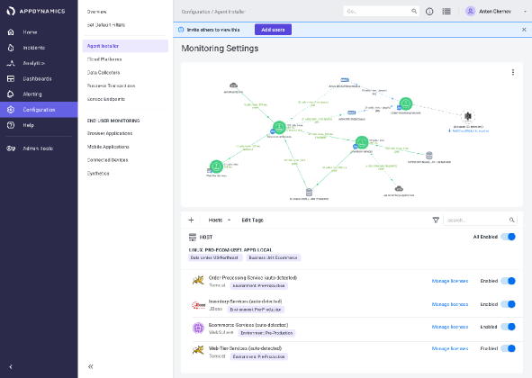
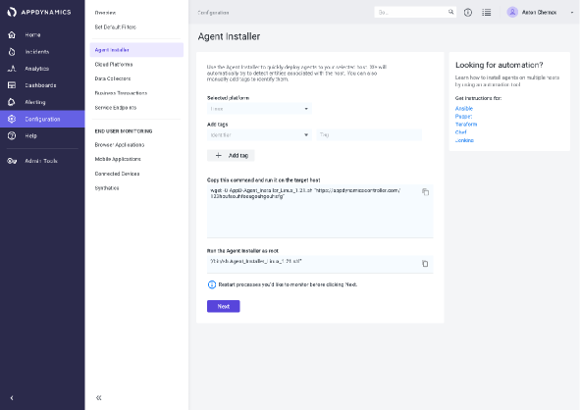
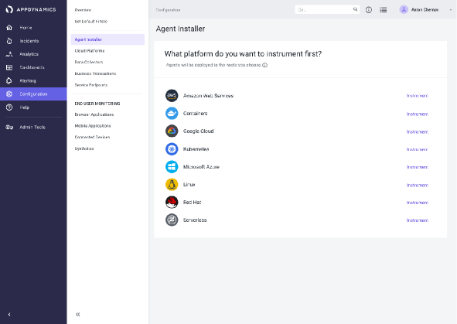
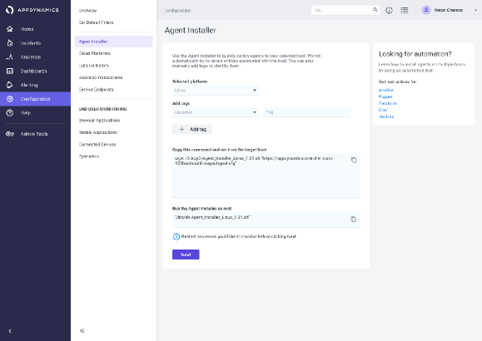
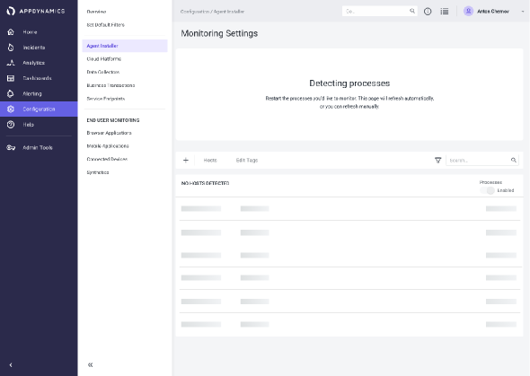
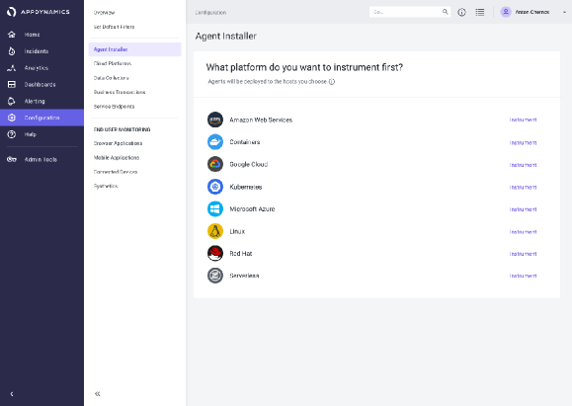

https://www.appdynamics.com
https://www.appdynamics.com
https://www.appdynamics.com
User Goal
Business Goal
Measures
Deliver a streamlined, automated solution that would enhance setup efficiency and clarity.
improve customer retention, enable more customers to self-serve and setup without the need of additional support
Reduce setup time, and improve
user satisfaction
Notes:
Once we had a vision we aspired to, we set out to build it.

Slide 6
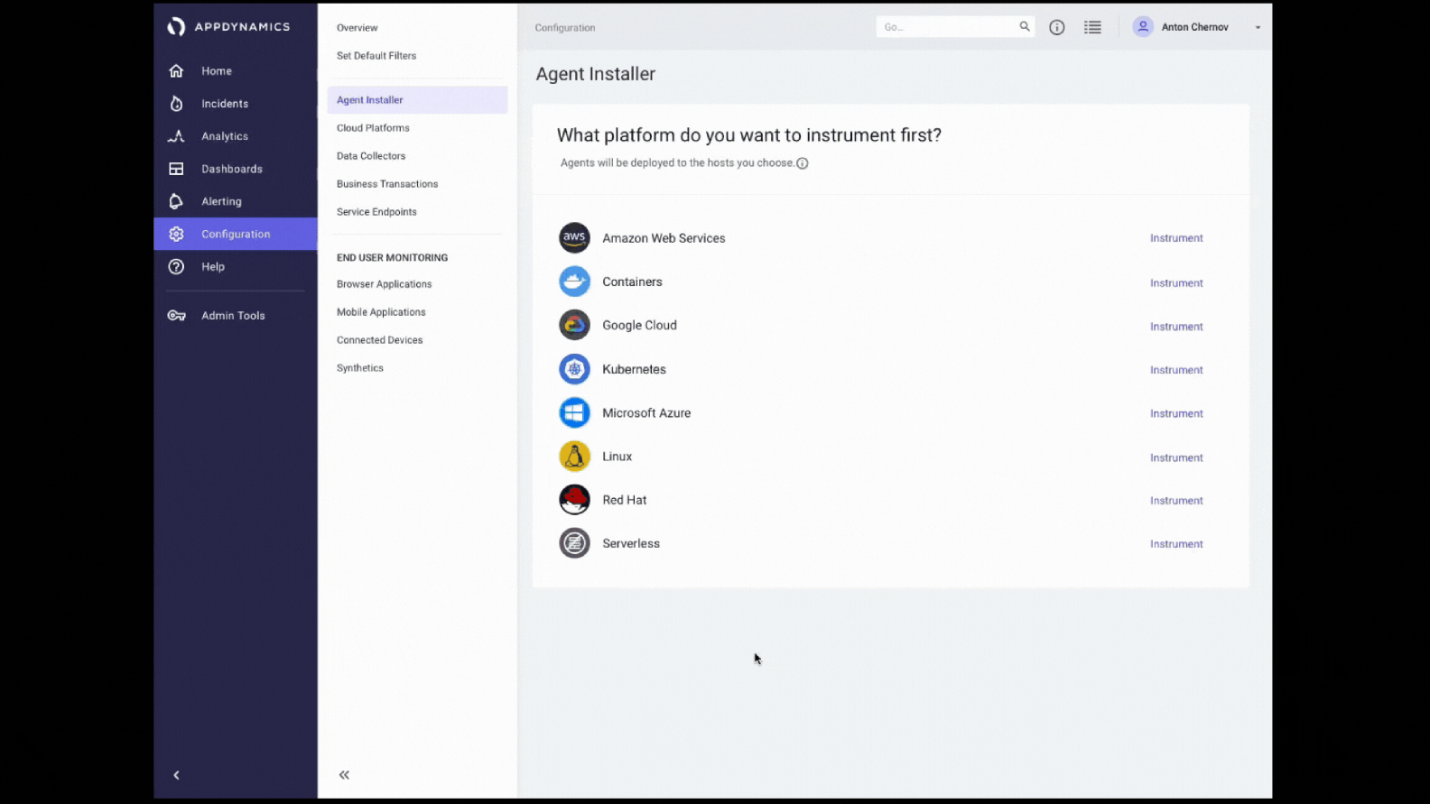
Notes:
This wasn’t just about solving immediate pain points. I designed a modular architecture that supported integrations with future tools and evolving enterprise needs.
Conducted a competitive analysis of industry leaders (Dynatrace, New Relic) and spoke with DevOps engineers to understand pain points and industry standards.
I created detailed interaction flows and prototypes that addressed the nuances of technical workflows, ensuring clarity and ease of use for developers across varying levels of expertise.
Simplified to single block of code
Enable grouping and sorting via tagging structure
Enabling self serve, by providing a UI to allow DevOps engineers to deploy independently
Reduce effort with automatic detection of all the process running via one click set up

Slide 7
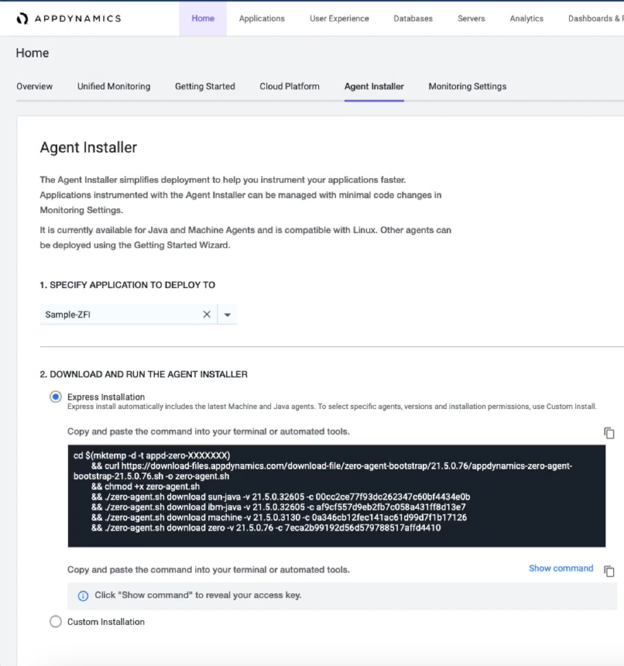
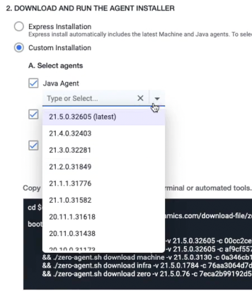
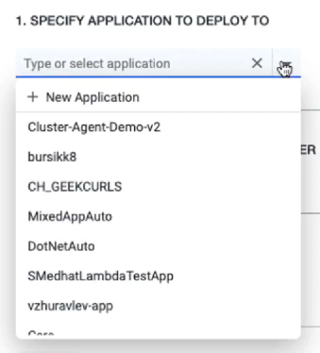
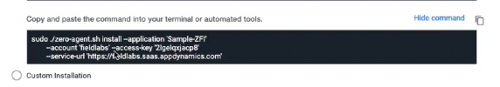
Simplifying complexity
Simplified complex flows: Redesigned the user journey for agent installation to reduce the number of steps by half.
The controller will give you a code snippet
You also have the option to pick and choose between the type and versions of these agents
Automated Process Detection: Enabled automatic detection of applications on the server, grouping them by relevance to reduce cognitive load.
Notes:
Adjusted design based on feedback to improve task flows and eliminate friction points, such as complex naming conventions.

Slide 8
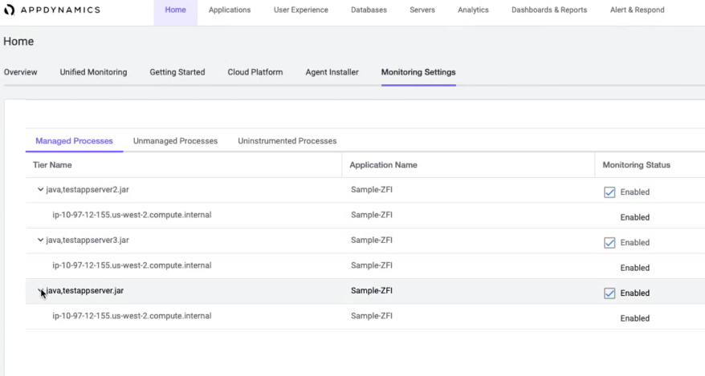
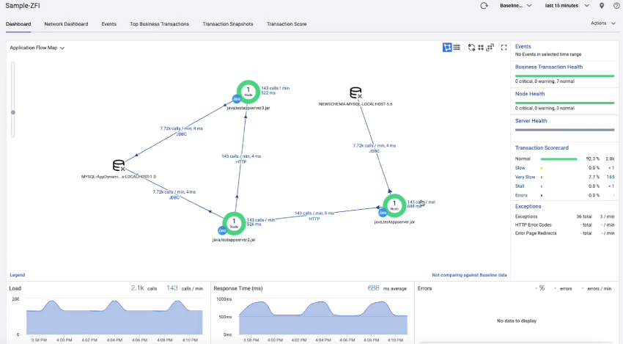
Simplifying complexity
Time savings through automation, detection and user-friendly labeling improved accessibility and reduced cognitive load.
Customization and control to monitor only important tiers
Automatically detected and processes visually mapped for monitoring
Putting control and customization directly in the hands of DevOps engineers
Notes:
Regularly engaging with engineers and stakeholders, I clearly articulated design rationale and trade-offs, such as balancing customization with simplicity to optimize usability.
Tradeoffs was in-context flow map
Worked closely with Product Managers to refine project scope based on user needs and development capabilities, ensuring alignment with business goals.

Slide 9

Notes:
The final platform simplified a complex, technical process into a seamless, self-service experience. Developers could now deploy agents in minutes, significantly improving productivity.
The developer has control of naming, which can be updated and changed
The option to pick and choose between the type and versions of these agents
Bulk install
Customization and control to monitor only important tiers
Automated Process Detection: Enabled automatic detection of applications on the server, grouping them by relevance to reduce cognitive load.
Auto-suggesting names

Slide 10


Results
01
Time Savings: Reduced setup time from MONTHS to MINUTES!
02
Customer Satisfaction: User feedback showed significant improvement in ease of use and setup efficiency, leading to reduced support requests.
03
Business Impact: The redesign helped retain customers who previously struggled with setup, aligning with the company’s business objective of reducing customer churn.
Notes:
By incorporating users into the feedback and testing, they felt heard, and involved
By conducting user interviews and analyzing workflows, I identified pain points and opportunities, ensuring the platform addressed immediate needs while laying the groundwork for future enhancements.
Streamlined task flows and automated tagging enabled more control and clarity for users managing large environments.
Key Metrics:
• Time Savings: Reduced setup time, allowing faster, more efficient installations.
• Customer Satisfaction: User feedback showed significant improvement in ease of use and setup efficiency, leading to reduced support requests.
• Business Impact: The redesign helped retain customers who previously struggled with setup, aligning with the company’s business objective of reducing customer churn.
• User-Centered Outcomes:
• Improved accessibility of the installation process, empowering DevOps professionals to perform installations independently, without the need for extensive support.
•

Slide 11
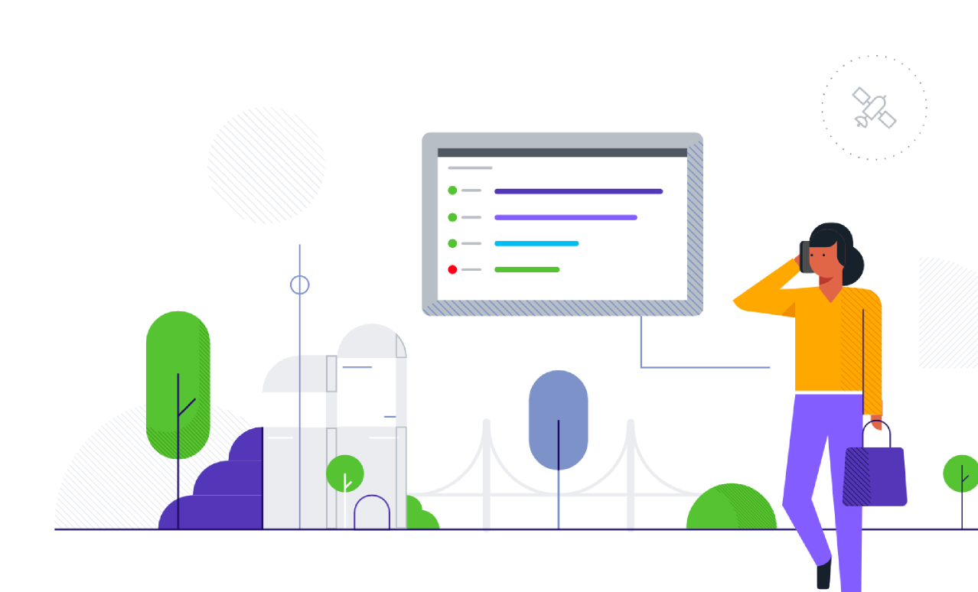
Learnings
Importance of automation for large-scale deployments and building solutions to support complex environments with simplified user flows.
Working closely with Engineering and Product taught me the value of ongoing alignment to ensure feasibility and maximize impact.
What Worked Well: Automation, detection and user-friendly labeling improved accessibility and reduced cognitive load.
Notes:
This taught me a lot about designing for scale, which helped significantly when designing for a multi-sided market place at One Medical
What I Learned:
• Importance of Automation: This project reinforced the impact that streamlined, automated solutions can have on user satisfaction and time savings.
• Collaboration: Working closely with Engineering and Product taught me the value of ongoing alignment to ensure feasibility and maximize impact.
• User-Centered Design: Validating designs with real users highlighted the importance of reducing cognitive load and complexity in enterprise software.
Impact: Successfully reduced agent installation setup time, increased customer satisfaction, and decreased support requests for installation help.
What Worked Well: Automation of process detection and user-friendly labeling improved accessibility and reduced cognitive load during installation.
Lessons Learned: Importance of providing bulk installation options for large-scale deployments and building solutions to support complex environments with simplified user flows.

